Slide 1
Flowcharts

Slide 2
Problem Solving
Computer programs are written to solve problems or perform tasks
Programmers translate the solutions or tasks into a language the computer can understand
The computer will only do what we instruct it to do
We need to be careful and thorough with our instructions

Slide 3
Designing a Computer Program
Determine what the output should be
Identify the data or input needed to produce that output
Determine how to process the input to obtain the desired output

Slide 4
Designing a Computer Program
Consider the following problem
  How fast is a car travelling if it travels 135 miles in 3 hours
  What is the type of answer required (the output)?
  What information (the input) is needed to obtain this output?
  What is the process that transforms the input into the output?

Slide 5
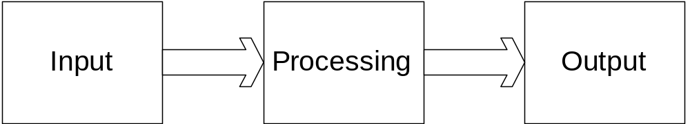
Pictorial Representation

Slide 6
Program Development
Consider the development process or strategy that should be adopted when developing a program similar to the ones you are/have developed in your programming course

Slide 7
Program Development
Analysis: Define the problem
Design: Plan the solution…a logical sequence of precise steps (Algorithm)
Implementation: Translate the algorithm into a programming language
Testing and Debugging: Locate and remove any errors in the program
Complete the documentation

Slide 8
Helpful Tools
Converting algorithms into computer programs
  Flowcharts – graphically depict the logical steps of the program and show how the steps are related to each other
  Pseudocode – Use English-like phrases with some programming terminology to outline the program

Slide 9
Flowcharts
Consists of geometric symbols connected by arrows
Within each symbol: a phrase presenting the activity at that step
Shape of symbol: indicates type of operation that is to take place
Arrows connecting symbols (flowlines): show the progression in which the steps take place

Slide 10
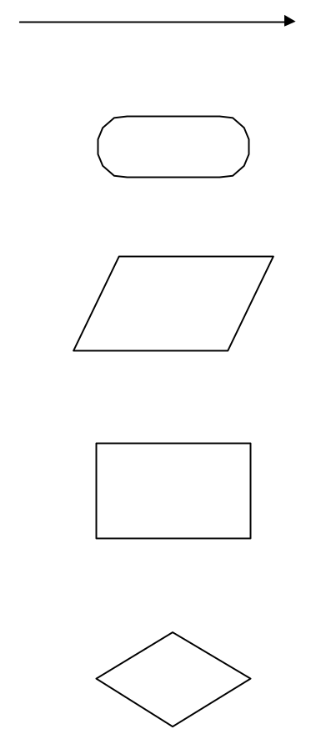
Flowchart Symbols
Flowline
Terminal
Input/Output
Processing
Decision

Slide 11
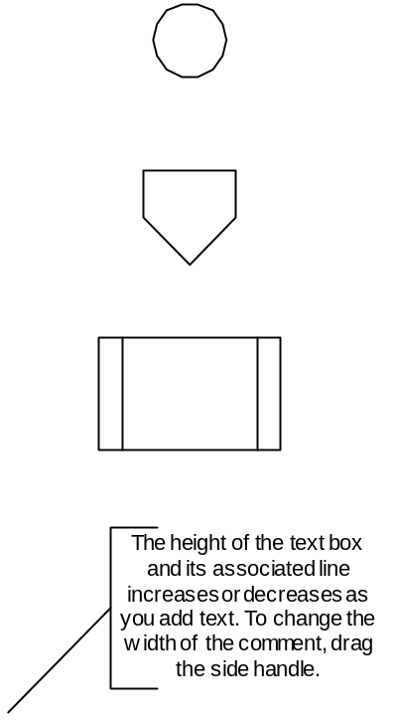
Flowchart Symbols
Connector
Off-page connector
Predefined Process
Annotations

Slide 12
Postage Stamp Problem
Algorithms are used every day for decision making
Consider the following problem
  Any time you post a letter you must decide how much postage to put on the envelope. One rule of thumb might be to use one stamp for every five sheets or fraction thereof. Suppose a colleague asks you to determine the number of stamps they need on an envelope. What algorithm should you adopt?

Slide 13
Algorithm for Postage Stamp Problem
Request the number of sheets of paper, call it sheets (input)
Divide Sheets by 5 (processing)
Round the quotient up to the next highest whole number, call it Stamps (processing)
Reply with the number Stamps (output)
Display graphically this algorithm, highlighting the input, processing and output
Task: Test the algorithm for letters with different numbers of stamps….

Slide 14
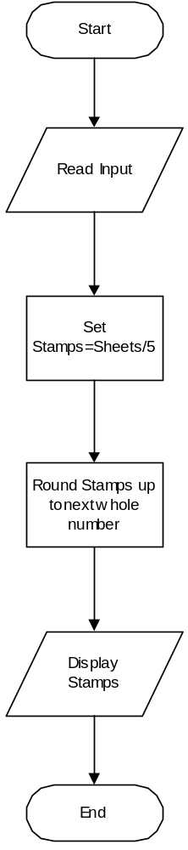
Flowchart for Postage stamp problem
Sequence Structure

Slide 15
Pseudocode for Postage Stamp Problem
Program: Determine the proper number of stamps for a letter
Read Sheets
Set the number of stamps to Sheets/5
Round the number of stamps up to the next whole number
Display the number of stamps

Slide 16
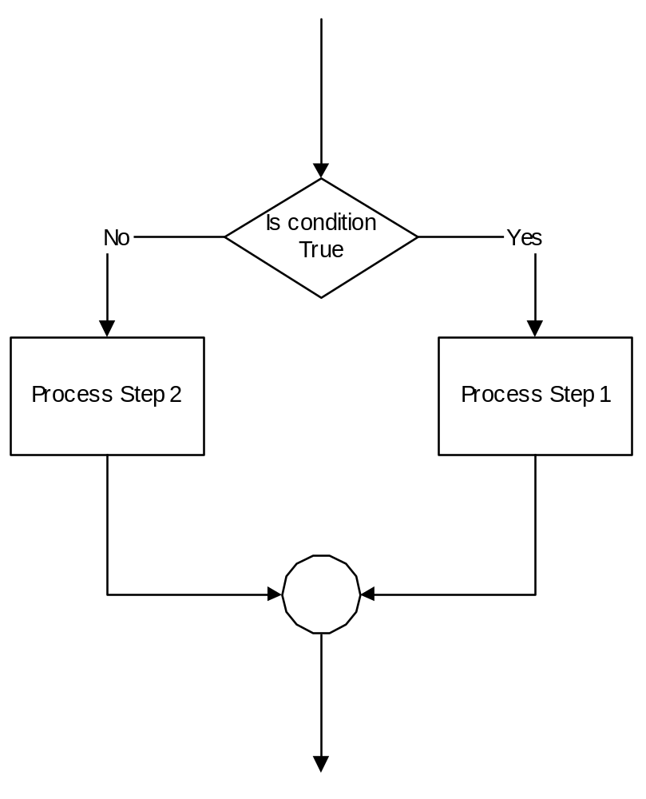
Including decisions in flowcharts
IF condition is true THEN
Process Step 1
ELSE
Process step 2
END IF

Slide 17
Combine Sequence and Decision Structures
Given a street number of a one-way street in New York, decide the direction of the street
  Rule: Even number means Eastbound street
Generate the pseudocode and flowchart for this problem
Recall:

Slide 18
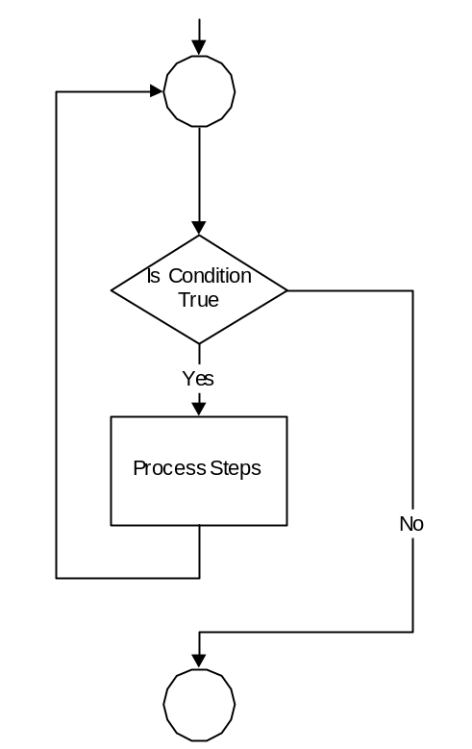
Loops in flowcharts
WHILE condition is true
Process Steps
LOOP

Slide 19
Problem
Calculate and report the average QCA for the class
Determine
  Input
  Processing
  Output

Slide 20

Symbols
Preparation (usually used for loops, i.e. the initialisation of variables)
In this lecture flowcharts for while, do-while and for loops that use and do not use the preparation symbol will be considered.

Slide 21
Links
http://www.eng.iastate.edu/efmd/161algor.htm
http://users.evtek.fi/~jaanah/IntroC/DBeech/3gl_flow.htm#exercise1
http://www.allclearonline.com/applications/DocumentLibraryManager/upload/program_intro.pdf
http://erc.msh.org/quality/example/exampl11.cfm
http://www.enm.bris.ac.uk/staff/pjn/EMAT10920/ (especially lesson 2)

Slide 22
Summary
Problem Solving
Designing a Computer Program
Input Processing and Output
Flowcharts and Pseudocode
Flowchart symbols
Flowchart sequence and decision
Looping in flowcharts

